Slide 1
Home Run Analytics
for the UMD Terrapins Baseball Team
Alan Cheng, Kyle Covello, Diamond Hawkins, John Yannone
November 22, 2021

Slide 2
Introduction
Mission Statement: To analyze the past games of the Terrapins Baseball Team and gain insight about game results across varying games, locations, opponents, and seasons.
Mission Objectives:
To find the top ten games with the highest number of runs by the Terrapins Baseball Team.
To find the top ten locations with the highest number of runs by the Terrapins Baseball Team.
To find the top ten opponents that won most often against the Terrapins Baseball Team.
To find the Terrapins Baseball Team’s average number of runs per game per season.
To find which season the Terrapins Baseball Team had the highest winning percentage.

Slide 3
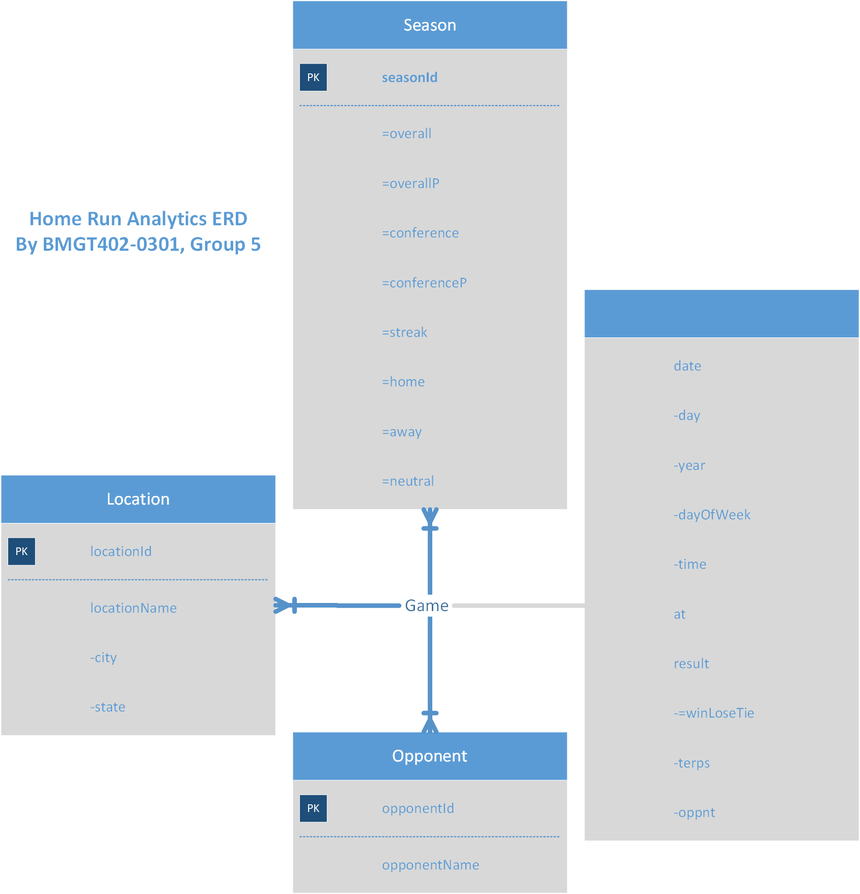
Conceptual Database Design

Slide 4
Logical Database Design
Season(seasonId)
Opponent(opponentId, opponentName)
Location(locationId, city, state)
Game(gameId, day, year, dayOfWeek, time, at, terps, oppnt,
opponentID, locationID)

Slide 5
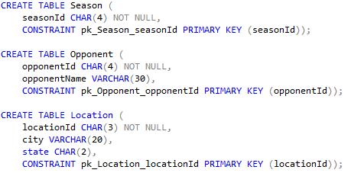
Physical Database Design

Slide 6
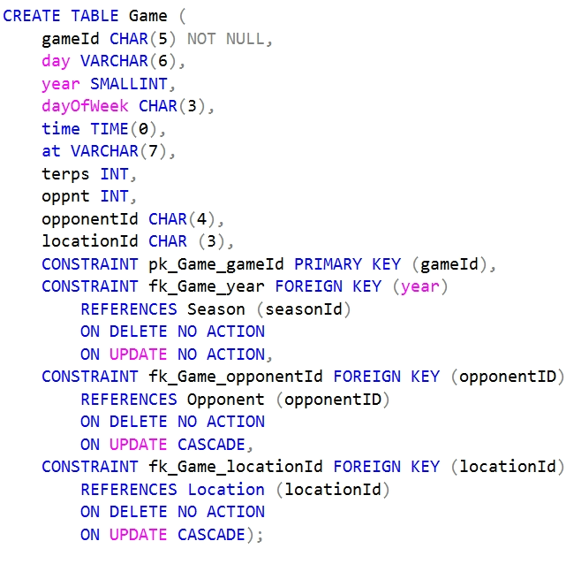
Physical Database Design (cont.)

Slide 7
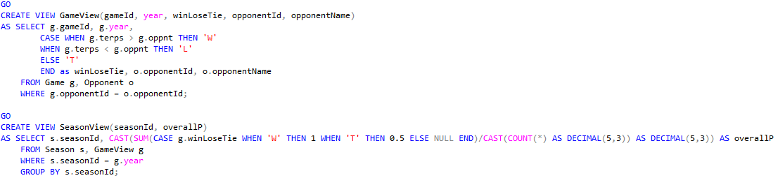
Physical Database Design (cont.)

Slide 8
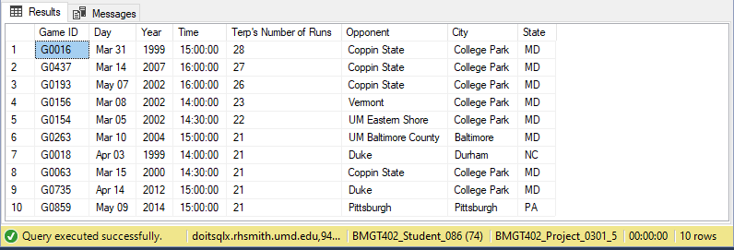
Business Transaction #1
What were the top ten games with the highest number of runs by the Terrapins Baseball Team?

Slide 9
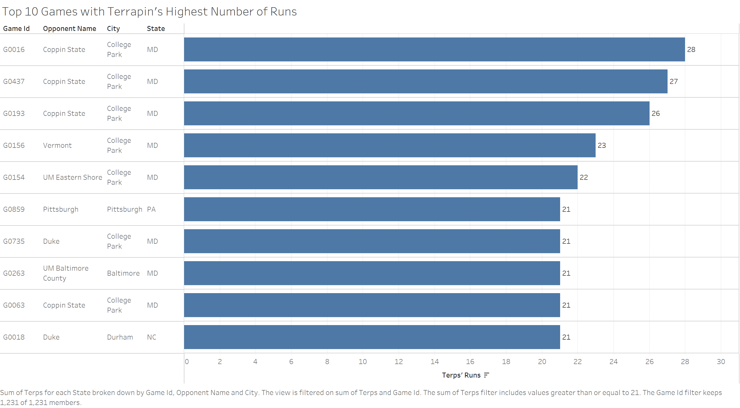
What were the top ten games with the highest number of runs by the Terrapins Baseball Team? - Visualized

Slide 10
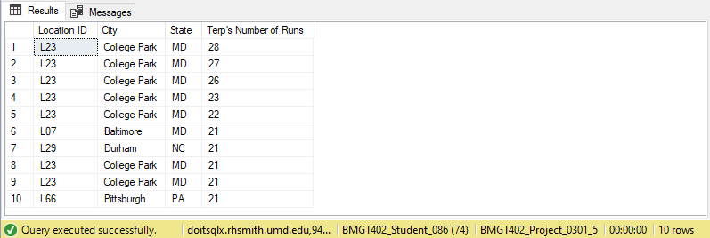
Business Transaction #2
What were the top ten locations with the highest number of runs by the Terrapins Baseball Team?

Slide 11
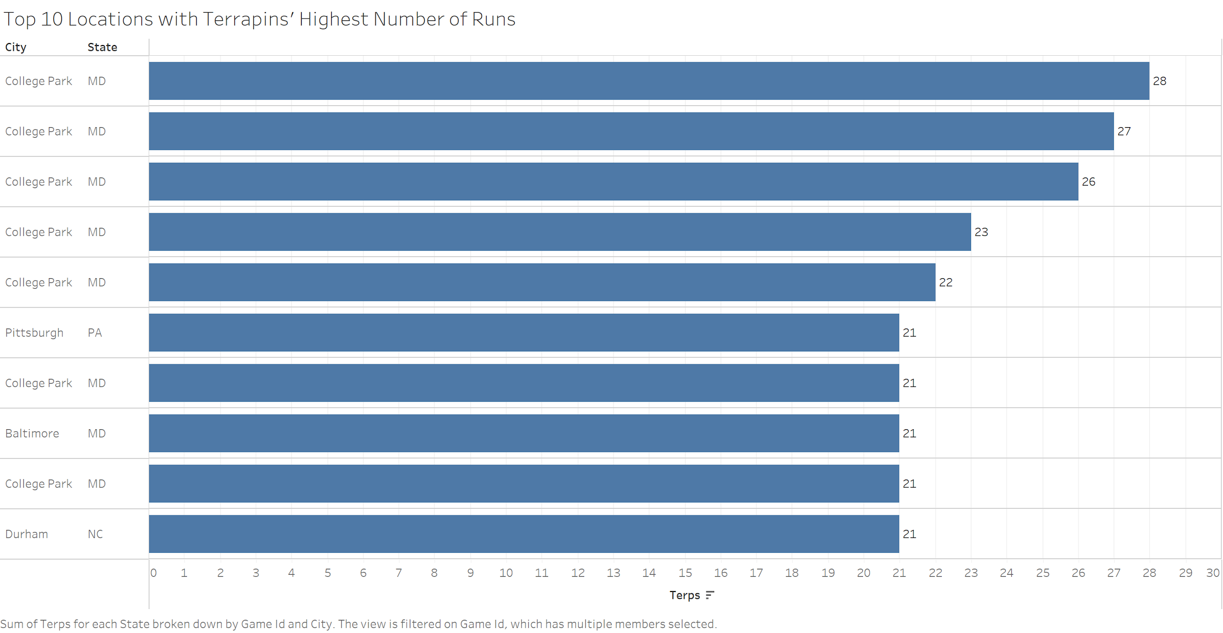
What were the top ten locations with the highest number of runs by the Terrapins Baseball Team? - Visualized

Slide 12
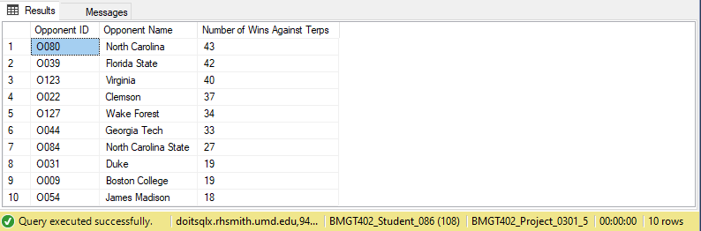
Business Transaction #3
Who were the top ten opponents that won most often against the Terrapins Baseball Team?

Slide 13
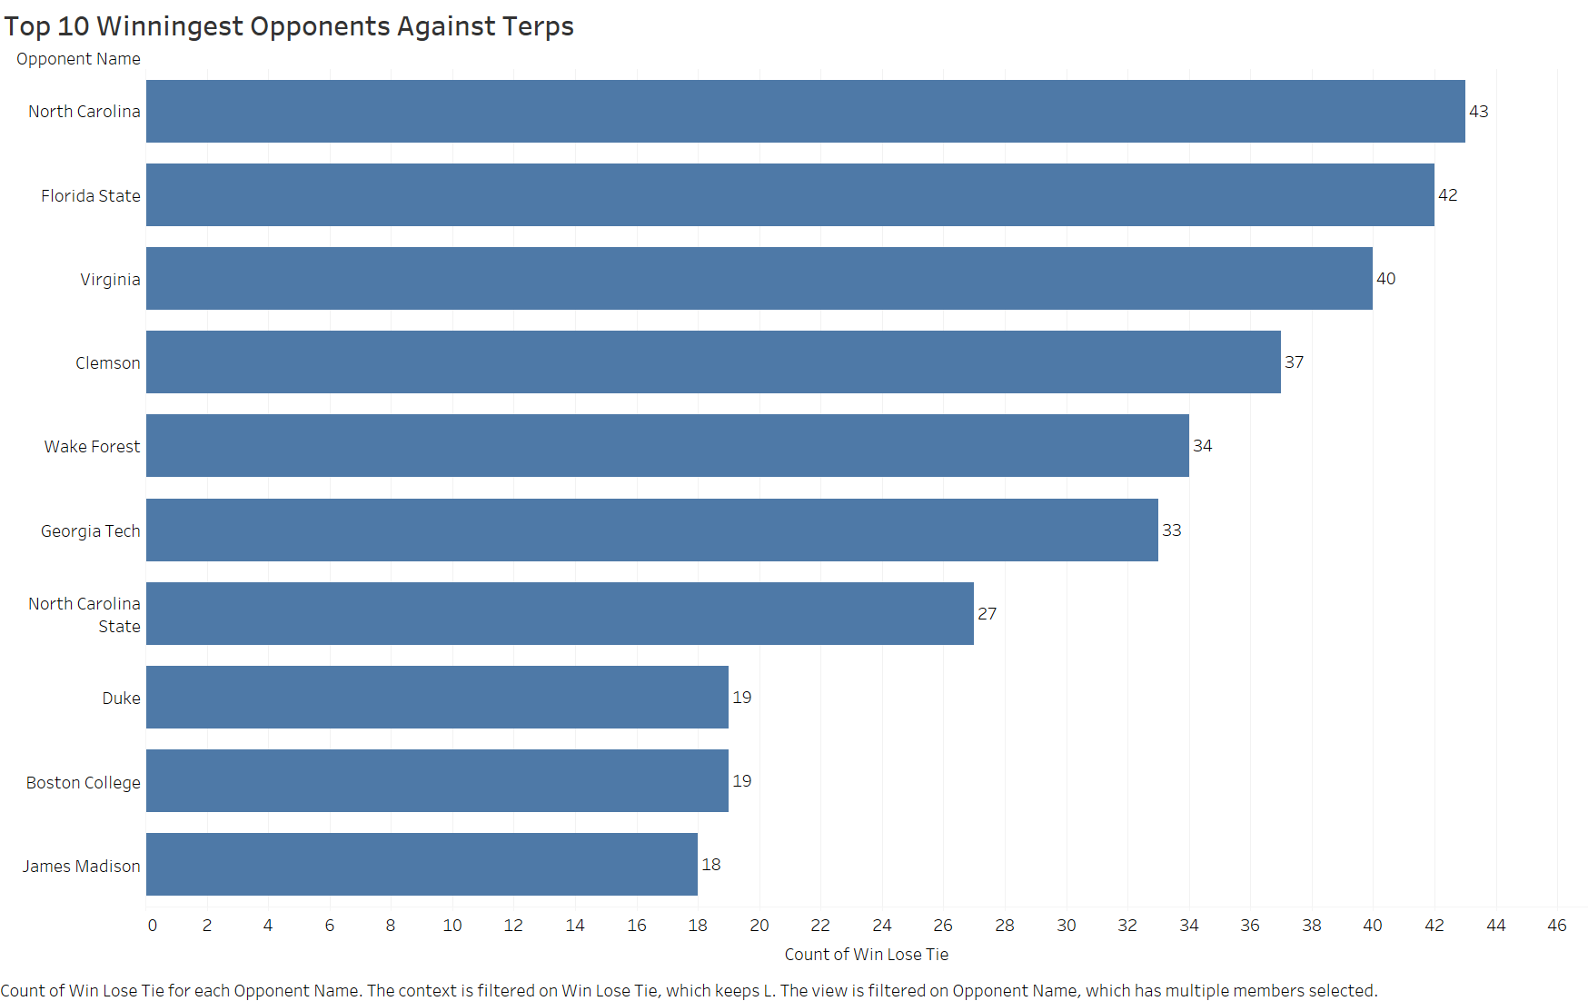
Who were the top ten opponents that won most often against the Terrapins Baseball Team? - Visualized

Slide 14

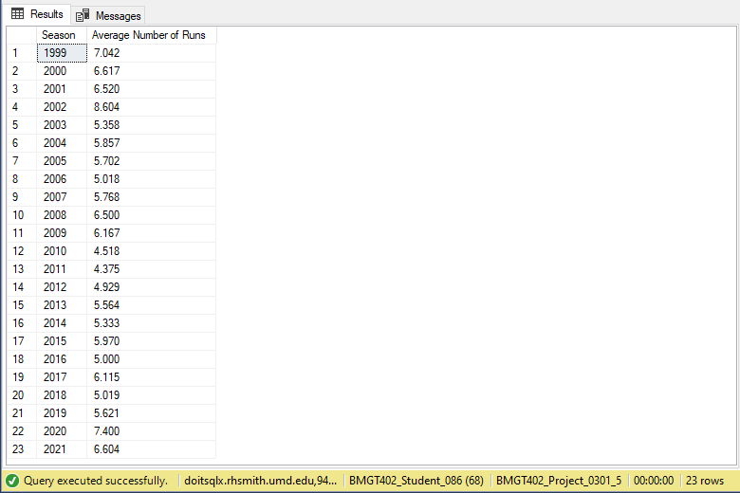
Business Transaction #4
What was the Terrapins Baseball Team's average number of runs per game per season?

Slide 15
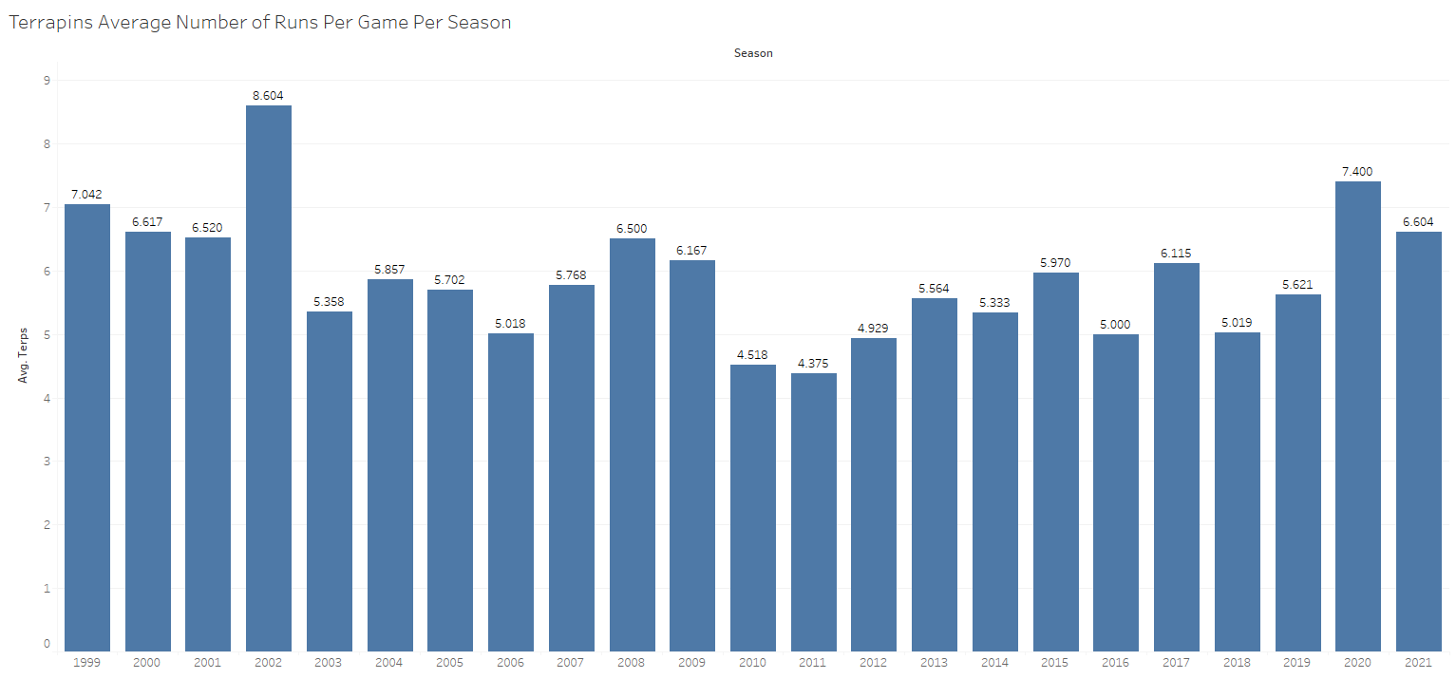
What was the Terrapins Baseball Team's average number of runs per game per season? - Visualized

Slide 16

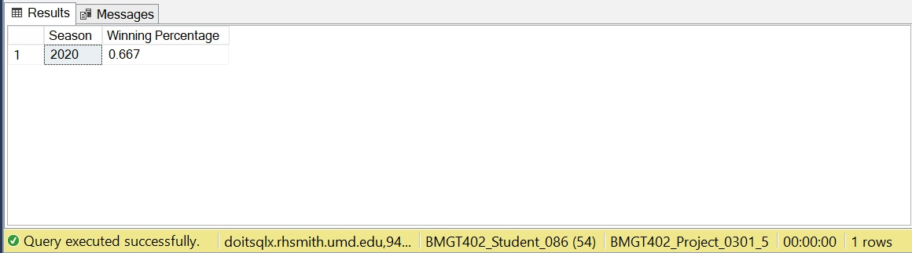
Business Transaction #5
Which season had the Terrapins Baseball Team’s highest overall winning percentage?

Slide 17
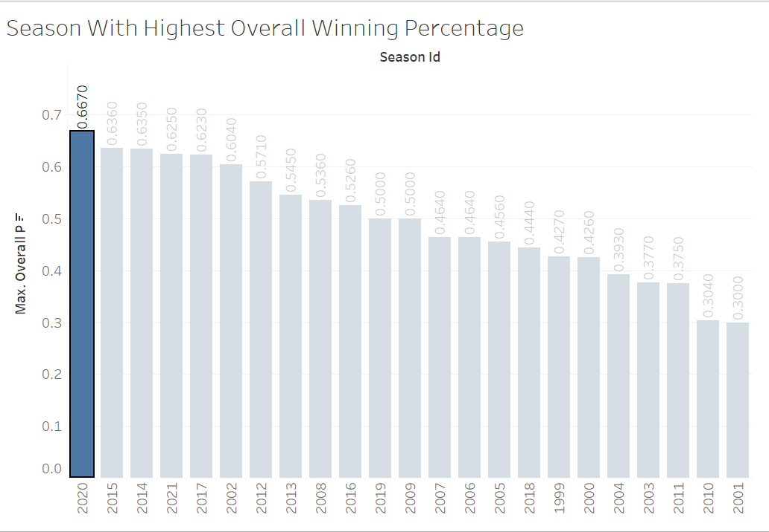
Which season had the Terrapins Baseball Team’s highest overall winning percentage? - Visualized

Slide 18
Questions?

